Slide 1

TIEGCM with AMIE
RENU Rocket Cusp Density
Tasks:
1) Collect data for ingestion into AMIE for RENU flight
(Magnetometers, SuperDARN, DMSP, AMPERE, RENU measurements)
Run TIEGCM with appropriate AMIE and Cusp Precipitation
Compare modeled and measured cusp density
3) Develop TIEGCM module to add field-aligned ion motion to forcing of neutrals
ASTRA LLC., Boulder, CO
1/3

Slide 2
AMIE Potential Patterns: RENU2
We have compared AMIE potential patterns to SuperDARN assimilative mapping (SAM) convection maps. These show that the SAM convection patterns are very close to a statistical model while the AMIE convection patterns are much more influenced by the assimilated data.
ASTRA LLC., Boulder, CO

Slide 3
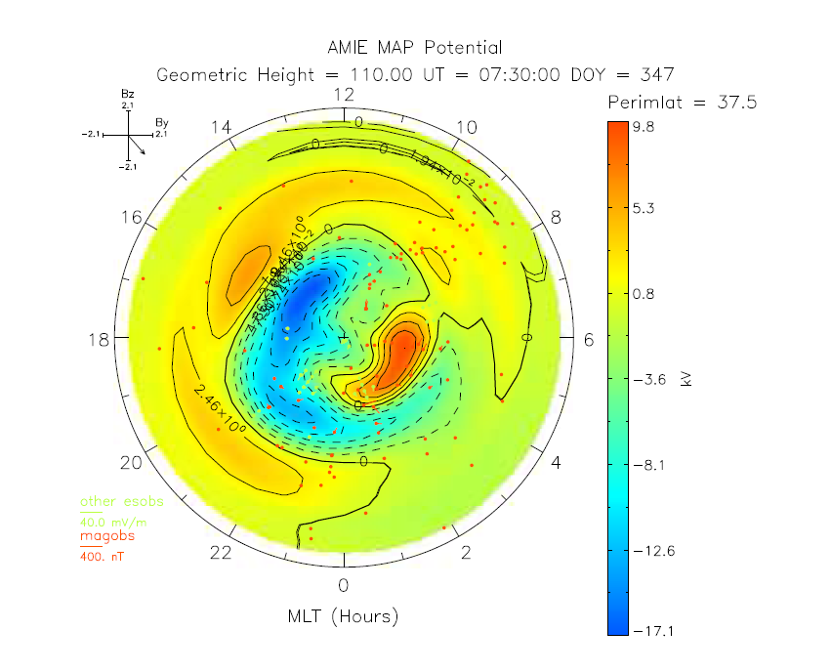
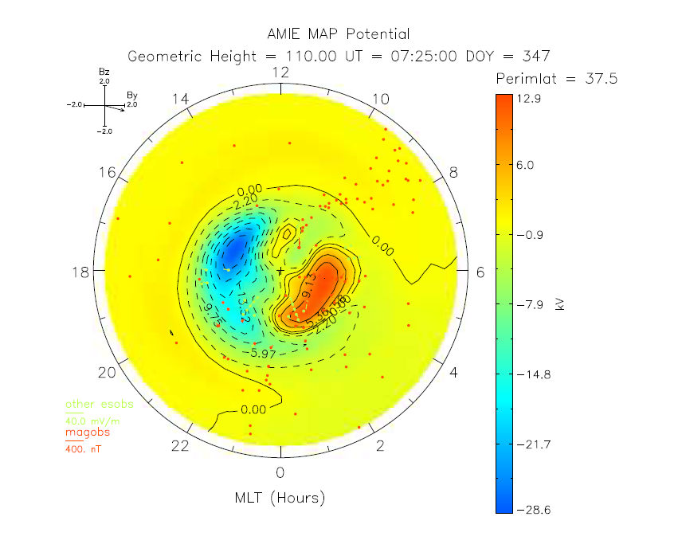
AMIE Potential Patterns: RENU2
(a) | (b)
ASTRA LLC., Boulder, CO

Slide 4
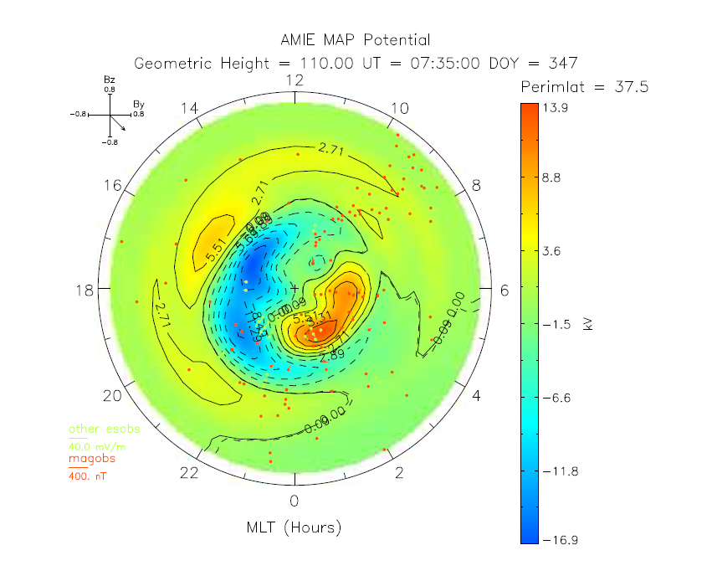
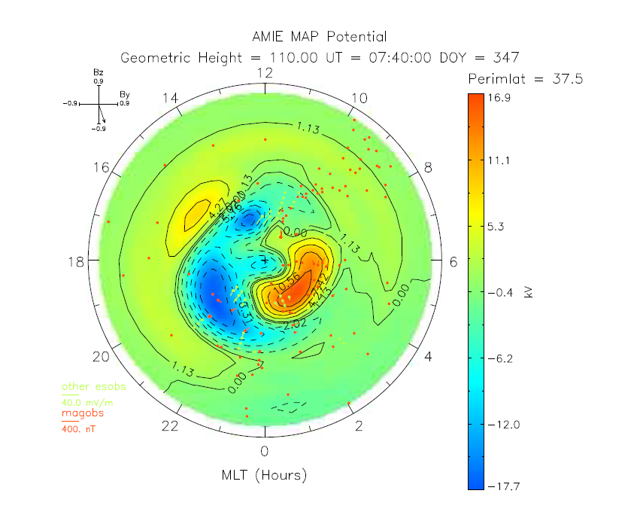
AMIE Potential Patterns: RENU2
(c) | (d)
ASTRA LLC., Boulder, CO

Slide 5
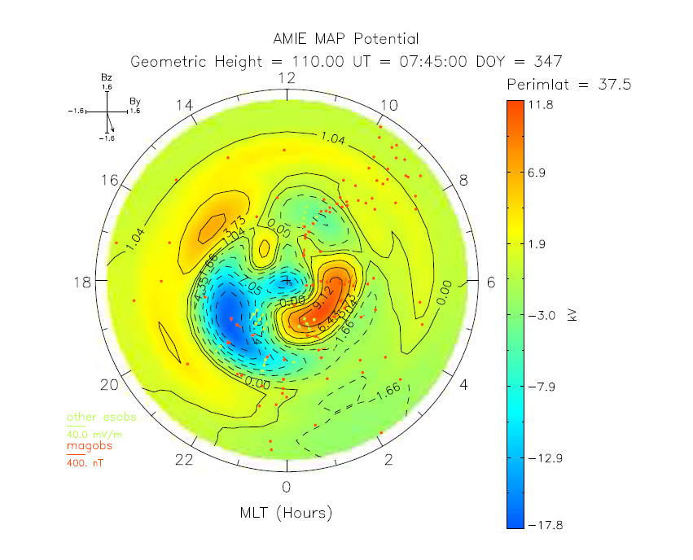
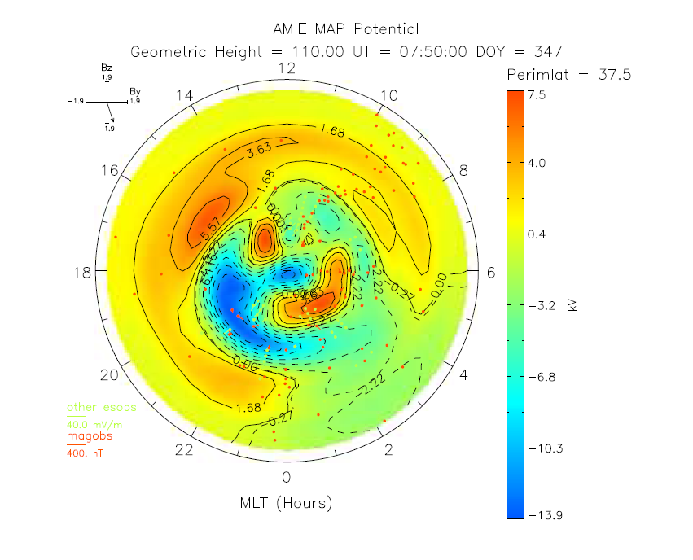
AMIE Potential Patterns: RENU2
(e) | (f)
We have compared AMIE potential patterns to SuperDARN assimilative mapping (SAM) convection maps. These show that the SAM convection patterns are very close to a statistical model while the AMIE convection patterns are much more influenced by the assimilated data.
ASTRA LLC., Boulder, CO

Slide 6
TIEGCM with AMIE
Cusp Precipitation
ASTRA LLC., Boulder, CO
6/3

Slide 8
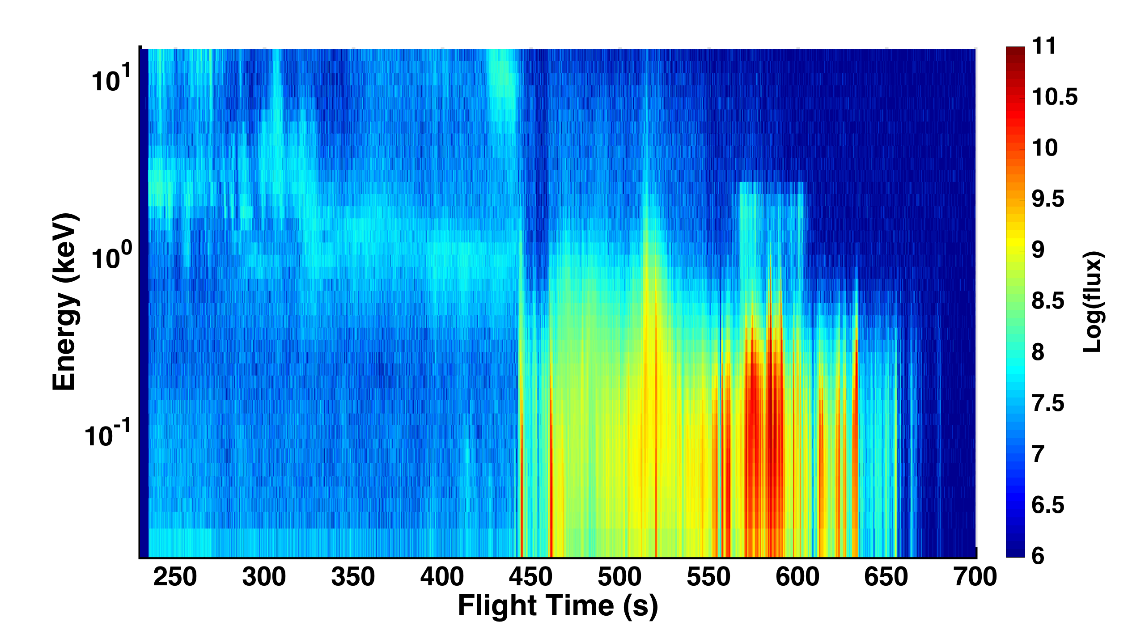
Measured Particle Spectrum: RENU2
ASTRA LLC., Boulder, CO

Slide 9
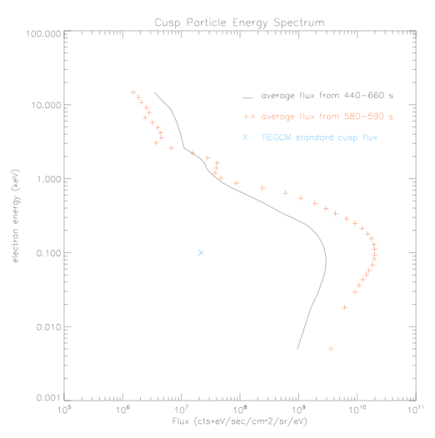

Slide 10
TIEGCM-AMIE: RENU2 x134 Cusp Precipitation
ASTRA LLC., Boulder, CO
10

Slide 11
TIEGCM Runs for RENU2
TIEGCM
  Energy = 100 eV
  Flux = 3.7×10¹⁰ #/s/cm²
ASTRA LLC., Boulder, CO
11

Slide 12
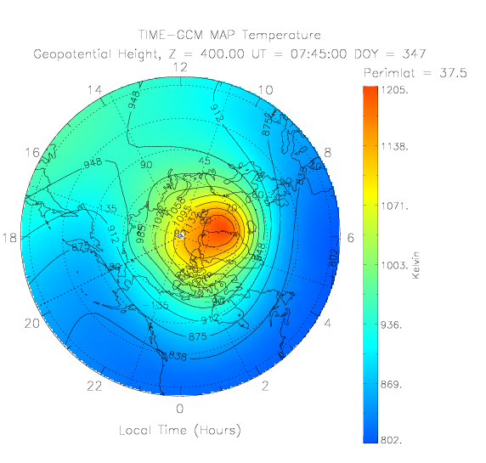
TIEGCM TN Dec 13, 2015 7:45 UT
ASTRA LLC., Boulder, CO
12

Slide 13
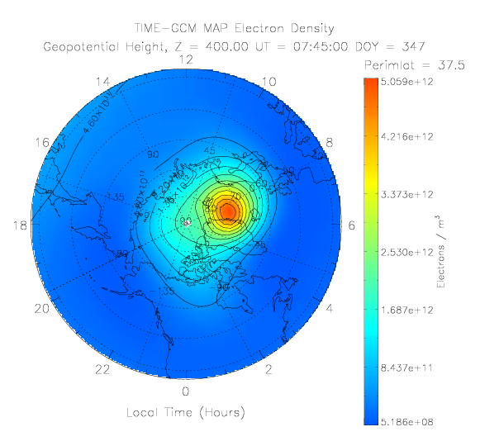
TIEGCM NE Dec 13, 2015 7:45 UT
ASTRA LLC., Boulder, CO
13

Slide 14
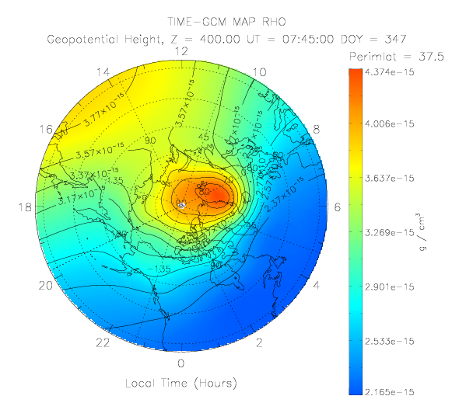
TIEGCM RHO Dec 13, 2015 7:45 UT
ASTRA LLC., Boulder, CO
14

Slide 15
TIEGCM RHO
ASTRA LLC., Boulder, CO
15

Slide 16
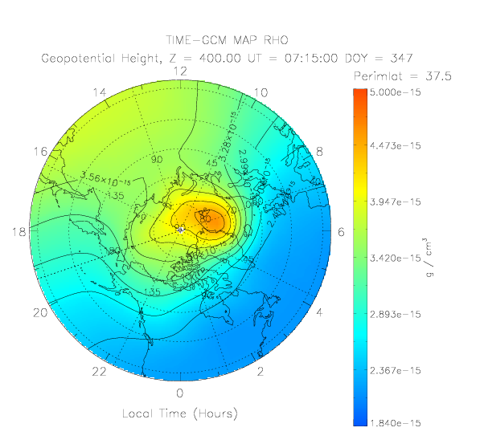
TIEGCM RHO Dec 13, 2015 7:15 UT
ASTRA LLC., Boulder, CO
16

Slide 17
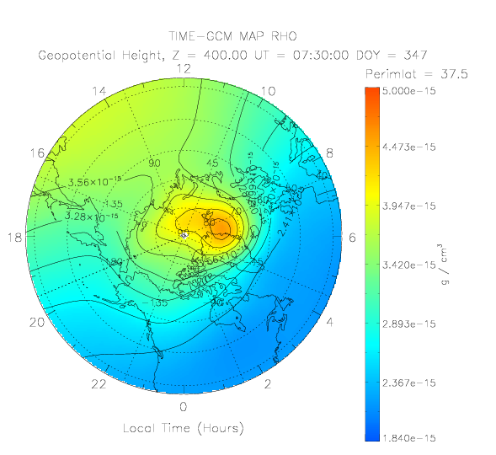
TIEGCM RHO Dec 13, 2015 7:30 UT
ASTRA LLC., Boulder, CO
17

Slide 18
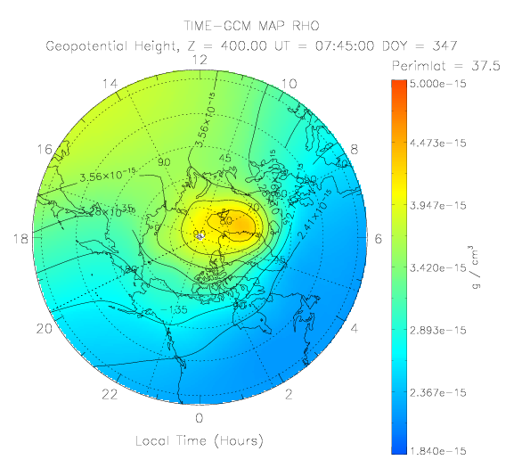
TIEGCM RHO Dec 13, 2015 7:45 UT
ASTRA LLC., Boulder, CO
18

Slide 19
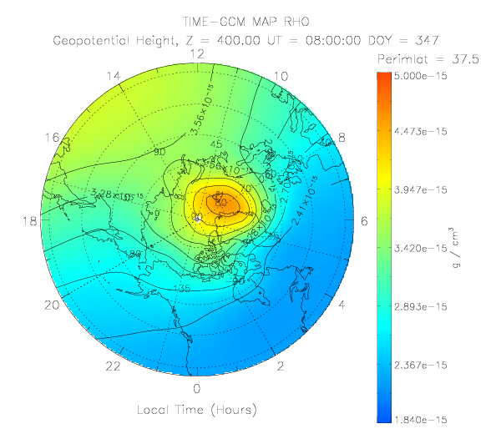
TIEGCM RHO Dec 13, 2015 8:00 UT
ASTRA LLC., Boulder, CO
19

Slide 21
TIEGCM-AMIE: RENU2 x898 Cusp Precipitation
ASTRA LLC., Boulder, CO
21

Slide 22
TIEGCM Runs for RENU2
TIEGCM
  Energy = 100 eV
  Flux = 2.5×10¹¹ #/s/cm²
ASTRA LLC., Boulder, CO
22

Slide 23
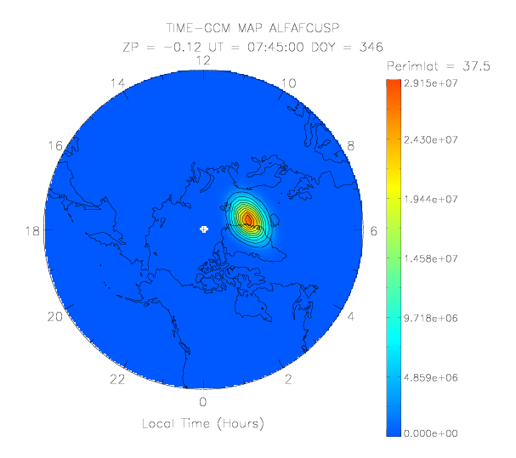
Cusp Location in TIEGCM-ICON
ASTRA LLC., Boulder, CO
23
Notes:
Flux = ALFAFCUSP/ALFA
Where ALFA = 0.1 ev

Slide 24
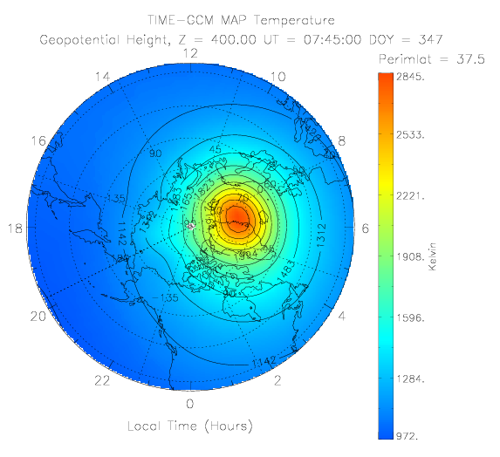
TIEGCM TN Dec 13, 2015 7:45 UT
ASTRA LLC., Boulder, CO
24

Slide 25
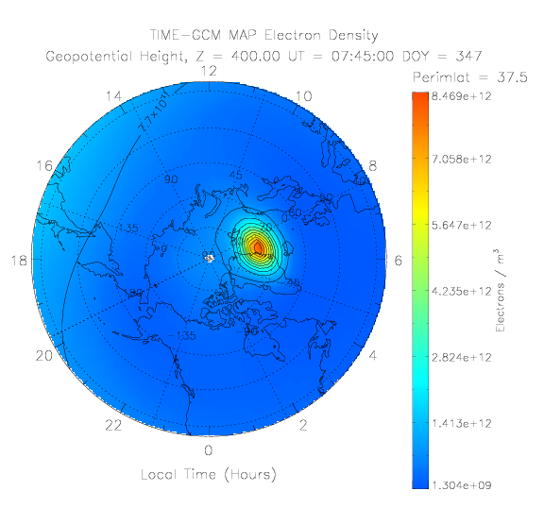
TIEGCM NE Dec 13, 2015 7:45 UT
ASTRA LLC., Boulder, CO
25

Slide 26
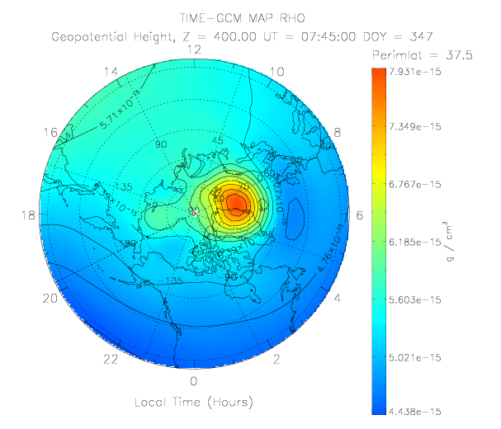
TIEGCM RHO Dec 13, 2015 7:45 UT
ASTRA LLC., Boulder, CO
26

Slide 27
ASTRA LLC., Boulder, CO
27

Slide 28
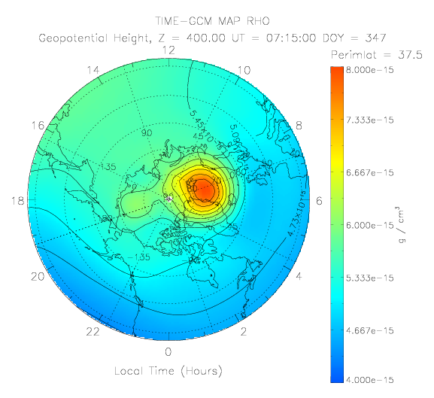
TIEGCM RHO Dec 13, 2015 7:15 UT
ASTRA LLC., Boulder, CO
28

Slide 29
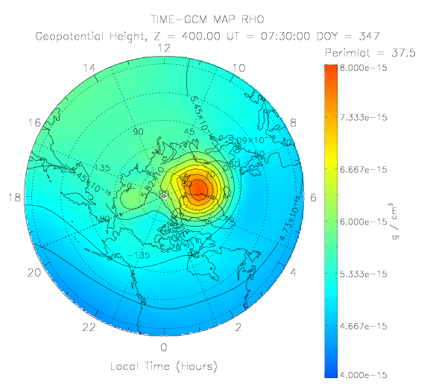
TIEGCM RHO Dec 13, 2015 7:30 UT
ASTRA LLC., Boulder, CO
29

Slide 30
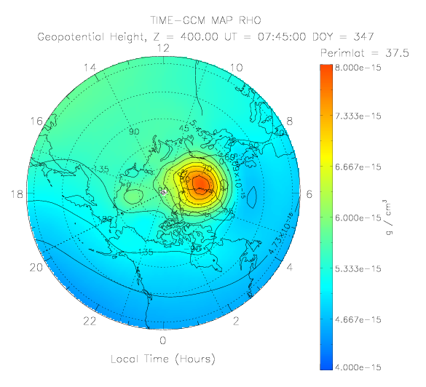
TIEGCM RHO Dec 13, 2015 7:45 UT
ASTRA LLC., Boulder, CO
30

Slide 31
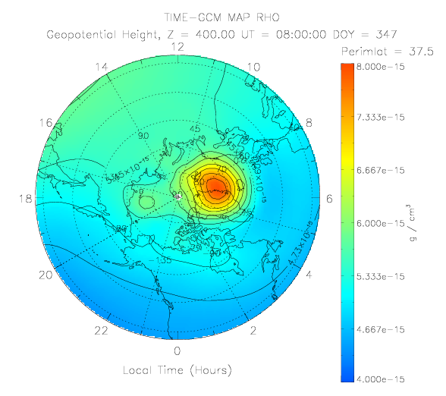
TIEGCM RHO Dec 13, 2015 8:00 UT
ASTRA LLC., Boulder, CO
31

